Slide 1



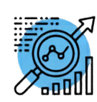
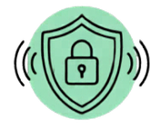
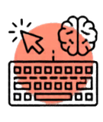

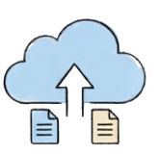

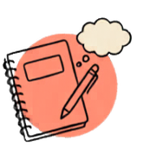
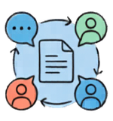


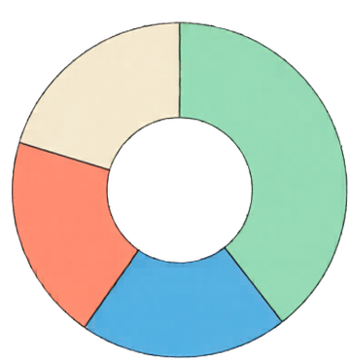







What is Digital Literacy?
The ability to effectively and safely navigate, evaluate, and create information using digital technologies.
Useful Digital Tools
Cloud Storage Apps
Video Conferencing Software
Note-taking Apps
Collaborative Platforms
Digital Wellbeing
Mindful Downtime (20%)
Take breaks regularly
Productive Work/Learning (40%)
Balanced Screen Time Habits
Customize notifications
Entertainment (20%)
Set boundaries
Social Connection (20%)

